Slide 1

Predictive Analytics in Business (BUAN 448)
BUAN 488 – Fall 2022 – Dr. Davoodi

Slide 2
Review

Slide 3
Review previous class
Main idea:
If we can quantify the relationship of how a single variable (referred as “dependent variable”) depends on other variables (referred as “independent” or “explanatory” variables)
→ then we can predict the unknown/future values and trends of the dependent variable using the values of these other variables
INFORMS Body of Analytics, Wiley 2018

Slide 4
Quantifying the relationship: Correlation as Indicator of Linear Relationships
Sign of the correlation can tell whether the two variables are positively or negatively related
A correlation close to 1 indicates a strong positive linear relationship
A correlation close to -1 indicates a strong negative linear relationship
A correlation equal to 0 (or near 0) indicates no linear relationship
Dependent
variable
Independent variable

Slide 5
Quantifying the relationship between two variables
Scatterplots and correlations are useful for indicating direction and strength of the relationship between variables
But do they quantify the relationship?
In other words, can we predict how (by how much) one variable changes if the other variable changes by one unit?

Slide 6
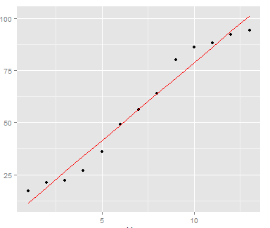
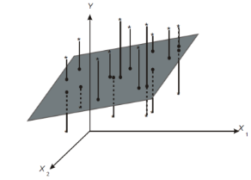

Univariate vs Multiple Regression: Graphical Comparison
Graphically, in univariate regression we are fitting a line to a set of points
In multiple regression, if there are two independent variables, we are fitting a plane to the data in three-dimensional space
$$y=a+β_{1}x_{1}+β_{2}x_{2}+ε$$

Slide 7
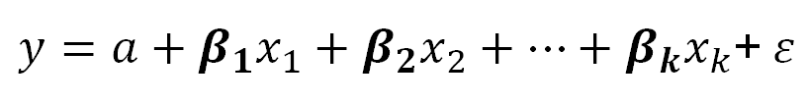
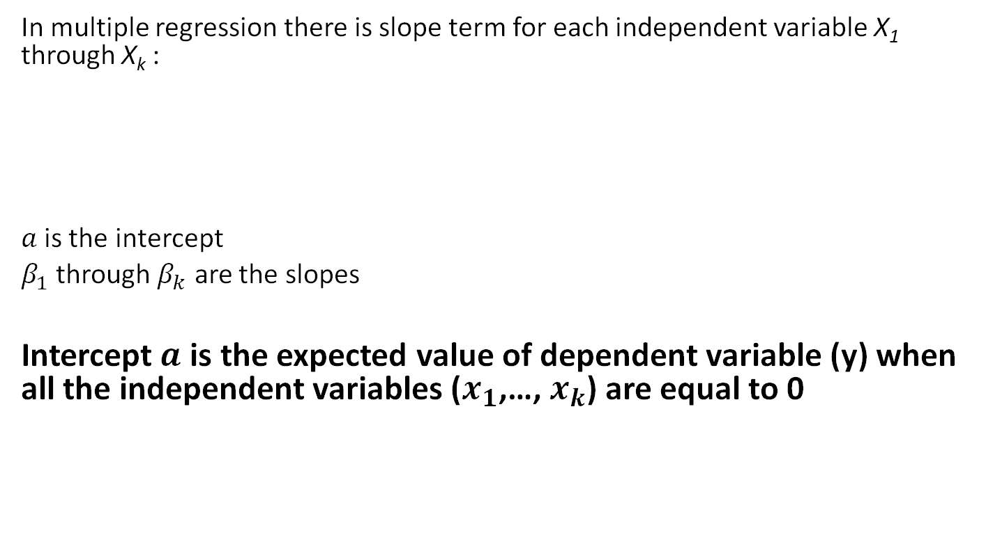
Interpretation of Regression Coefficients
In multiple regression there is slope term for each independent variable X₁ through X_{k} :
$a$is the intercept
$β_{1}$ through $β_{k}$ are the slopes
Intercept$a$ is the expected value of dependent variable (y) when all the independent variables ($x_{1}$,…, $x_{k}$) are equal to 0
$y=a+β_{1}x_{1}+β_{2}x_{2}+…+β_{k}x_{k}$+$ε$

Slide 8
Recall: Percentage of Variation Explained using R-Square
R Square is a measure of goodness of fit of the least squares line for univariate linear regression
Percentage of variation of the dependent variable explained by the regression
Always ranges between 0 and 1
The better the linear fit is, the closer R Square is to 1
R-Square has a drawback: It can only increase when additional independent variables are added to the regression model

Slide 9
Interpretation of R-Square and Adjusted R-Square
Adjusted R-Square is an alternative measure that adjusts R² for the number of explanatory variables in the equation
Helps to monitor whether extra explanatory variables really belong in the equation
It can decrease if unnecessary variables are added to the multivariate regression model
Penalty for number of predictors that do not fit the model

Slide 10
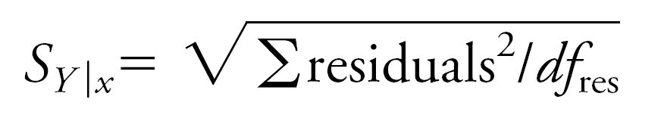
Key Insight: R Square, Adjusted R Square, and Standard Error of Estimate Important!!!
Sometimes a regression equation is “built” by successively adding independent variables to an equation – assuming more variables is better…
As more independent variables are added, it is a mathematical fact that R Square must increase; it cannot decrease
However, the standard error of estimate can increase, and the adjusted R square can decrease
each signaling that the extra independent variables are not useful and should probably be omitted from the equation

Slide 11
Regression Analysis Types
Based on the purpose
To understand the relationship between variables
To predict future (unknown) values of the dependent variable using the independent variables

Slide 12
Explanatory Modeling
Goal: Explain relationship between predictors (explanatory variables) and target
Familiar use of regression in data analysis
Model Goal: Fit the data well and understand the contribution of explanatory variables to the model
“goodness-of-fit”: R², residual analysis, p-values

Slide 13
Predictive Modeling
Goal: predict target values in other data where we have predictor values, but not target values
Classic data mining context
Model Goal: Optimize predictive accuracy
Train model on training data
Assess performance on validation (hold-out) data
Explaining role of predictors is not primary purpose (but useful)

Slide 14
Example: Prices of Toyota Corolla ToyotaCorolla.xls
Goal: predict prices of used Toyota Corollas based on their specification
Data: Prices of 1442 used Toyota Corollas, with their specification information

Slide 15
Variables Used
Price in Euros
Age in months as of 8/04
KM (kilometers)
Fuel Type (diesel, petrol, CNG)
HP (horsepower)
Metallic color (1=yes, 0=no)
Automatic transmission (1=yes, 0=no)
CC (cylinder volume)
Doors
Quarterly_Tax (road tax)
Weight (in kg)

Slide 16
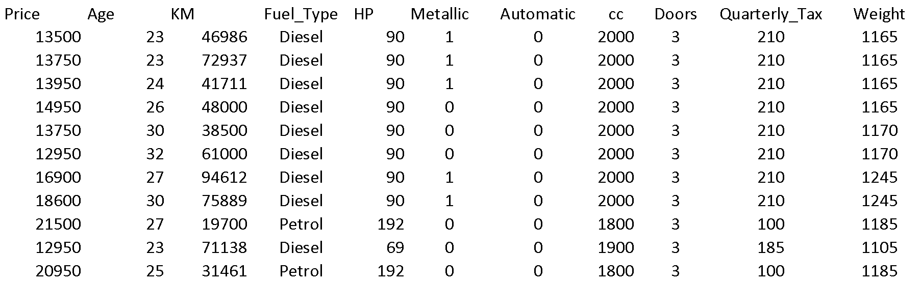
Data Sample (showing only the variables to be used in analysis)

Slide 17
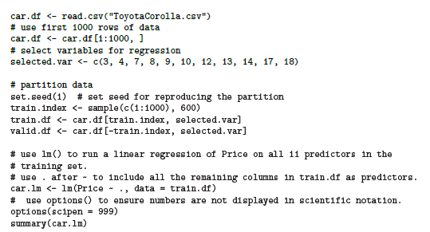
Fitting a Regression Model to the Toyota Data
put 60% in training
correction: 10
© Galit Shmueli and Peter Bruce 2017

Slide 18
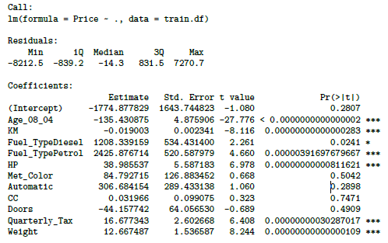
Output of the Regression Model
© Galit Shmueli and Peter Bruce 2017

Slide 19
Measuring Predictive error
Not the same as “goodness-of-fit”
We want to know how well the model predicts new data, not how well it fits the data it was trained with
Key component of most measures is difference between actual y and predicted y (“error”)

Slide 20
How Well did the Model Do With the Validation Data?
# use accuracy() to compute common accuracy measures.
accuracy(car.lm.pred, valid.df$Price)
ME = mean error (Gives an idea of systematic over- or under-prediction)
RMSE = root mean squared error
(sq. root of mean squared error)
MAE = mean absolute error (Gives an idea of the magnitude of errors)
MPE = mean percent error
MAPE = mean absolute percent error
accuracy(car.lm.pred, valid.df$Price)
ME RMSE MAE MPE MAPE
Test set 19.6 1325 1049 -0.75 9.35
© Galit Shmueli and Peter Bruce 2017

Slide 21
Reducing the number of Predictors

Slide 22
Reducing the Number of Predictors
Given the high speed of modern algorithms
Why bother to select a subset?
Several reasons for exercising caution before throwing all possible variables into a model.
Expensive or not feasible to collect
Measure fewer predictors more accurately
Less missing values with fewer predictors
More insight into the influence of predictors in models with few parameters (Parsimony property)
Multicollinearity issues
Adding uncorrelated predictors increases the variance of predictions.
Dropping correlated predictors can increase the average error of predictions.

Slide 23
How to Reduce Predictors
The first step always is to use domain knowledge.
why they are relevant for predicting the outcome variable
The outcome of the first step is a sensible set that reflects the problem at hand
Second step: searching for some reasons to eliminate
Expense of collecting this information in the future
Inaccuracy
High correlation with another predictor
Many missing values
Simply irrelevance
Last step: statistical performance metrics

Slide 24
Selecting Subsets of Predictors
Goal: Find parsimonious model (the simplest model that performs sufficiently well)
More robust
Higher predictive accuracy
We will assess predictive accuracy on validation data
Exhaustive Search = “best subset”
Partial Search Algorithms
Forward
Backward
Stepwise
© Galit Shmueli and Peter Bruce 2017

Slide 25
Exhaustive Search = Best Subset
All possible subsets of predictors assessed (single, pairs, triplets, etc.)
Computationally intensive, not feasible for big data (Predictors > 25)
How many subsets if the number of predictor is N?
2^{N}-1
N=25 ==> 2^{N}-1 = 33,554,431
N=10 ==> 2^{N}-1 = 1,023
N=7 ==> 2^{N}-1 = 127
© Galit Shmueli and Peter Bruce 2017

Slide 26
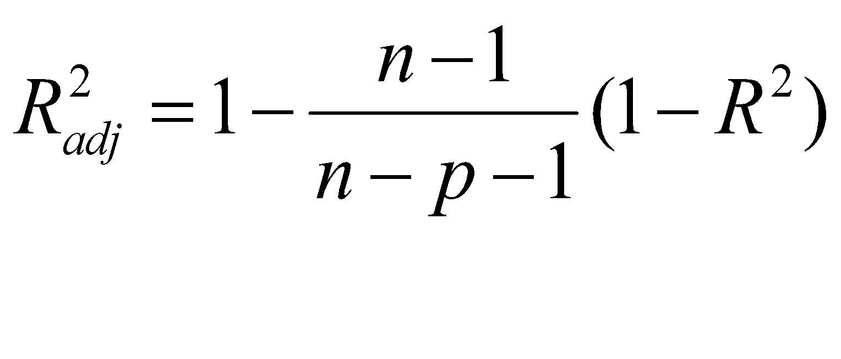
Exhaustive Search = Best Subset
To compare all possible subsets of predictors
First criterion: Judge by “adjusted R²”
Penalty for number of predictors
© Galit Shmueli and Peter Bruce 2017

Slide 27
Exhaustive Search = Best Subset
Why R²_{adj} not R² ?
R² means
How well the data points fit a curve or line (variability)
Adding more predictors increases R².
R²_{adj} penalize you for adding independent variables (p in the equation), so R²_{adj} can be decreasing.
Under-fit: too simplistic in terms of excluding important parameters
Over-fit: overly complex thereby modeling random noise
© Galit Shmueli and Peter Bruce 2017

Slide 28
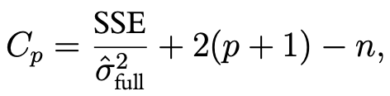
Exhaustive Search = Best Subset
Second measure is to balance between over-fitting and under-fitting (consider goodness of fit, the lowest is better)
Akaike Information Criterion (AIC)
Schwartz’s Bayesian Information Criterion (BIC)
Third criterion is Mallow’s C_{p}.
C_{p} near p + 1 and that have small p
© Galit Shmueli and Peter Bruce 2017

Slide 29
Exhaustive search requires library leaps and manual coding into binary dummies
library(leaps)
Fuel_Type <- as.data.frame(model.matrix(~ 0 + Fuel_Type, data=train.df))
train.df <- cbind(train.df[,-4], Fuel_Type[,])
head(train.df)
search <- regsubsets(Price ~ ., data = train.df, nbest = 1, nvmax = dim(train.df)[2], method = “exhaustive”)
sum <- summary(search)
sum$which
sum$rsq
sum$adjr2
sum$cp
sum$bic
show models
show metrics
© Galit Shmueli and Peter Bruce 2017

Slide 30
Adjusted R² for the models with 1 predictor, 2 predictors, 3 predictors, etc. (exhaustive search method)
Adjusted R² rises until you hit 7-8 predictors, then stabilizes, so choose model with 7 predictors, according to the adj R² criterion
rsq adjr2 cp bic
[1,] 0.7485597 0.7482670 599.710620 -1175.137
[2,] 0.7884998 0.7880068 370.319245 -1317.314
[3,] 0.8318137 0.8312249 121.381610 -1507.858
[4,] 0.8442542 0.8435264 51.308068 -1567.265
[5,] 0.8476864 0.8467957 33.423482 -1579.693
[6,] 0.8524991 0.8514628 7.541474 -1600.579
[7,] 0.8531315 0.8519263 5.877371 -1597.521
[8,] 0.8533548 0.8519779 6.583591 -1592.073
[9,] 0.8534540 0.8519042 8.008921 -1585.897
[10,] 0.8534553 0.8517313 10.001446 -1579.147
[11,] 0.8534556 0.8515569 12.000000 -1572.390
© Galit Shmueli and Peter Bruce 2017

Slide 31
Exhaustive output shows best model for each number of predictors
(Intercept) Age_08_04 KM Fuel_TypeDiesel Fuel_TypePetrol HP Met_Color Automatic CC Doors Quarterly_Tax Weight
1 TRUE TRUE FALSE FALSE FALSE FALSE FALSE FALSE FALSE FALSE FALSE FALSE
2 TRUE TRUE FALSE FALSE FALSE FALSE FALSE FALSE FALSE FALSE FALSE TRUE
3 TRUE TRUE TRUE FALSE FALSE FALSE FALSE FALSE FALSE FALSE FALSE TRUE
4 TRUE TRUE TRUE FALSE FALSE TRUE FALSE FALSE FALSE FALSE FALSE TRUE
5 TRUE TRUE TRUE FALSE TRUE FALSE FALSE FALSE FALSE FALSE TRUE TRUE
6 TRUE TRUE TRUE FALSE TRUE TRUE FALSE FALSE FALSE FALSE TRUE TRUE
7 TRUE TRUE TRUE TRUE TRUE TRUE FALSE FALSE FALSE FALSE TRUE TRUE
8 TRUE TRUE TRUE TRUE TRUE TRUE FALSE TRUE FALSE FALSE TRUE TRUE
9 TRUE TRUE TRUE TRUE TRUE TRUE TRUE TRUE FALSE FALSE TRUE TRUE
10 TRUE TRUE TRUE TRUE TRUE TRUE TRUE TRUE TRUE FALSE TRUE TRUE
11 TRUE TRUE TRUE TRUE TRUE TRUE TRUE TRUE TRUE TRUE TRUE TRUE
Age_08_04 KM Fuel_TypeDiesel Fuel_TypePetrol HP Met_Color Automatic CC Doors Quarterly_Tax Weight
1 ( 1 ) "*" " " " " " " " " " " " " " " " " " " " "
2 ( 1 ) "*" " " " " " " " " " " " " " " " " " " "*"
3 ( 1 ) "*" "*" " " " " " " " " " " " " " " " " "*"
4 ( 1 ) "*" "*" " " " " "*" " " " " " " " " " " "*"
5 ( 1 ) "*" "*" " " "*" " " " " " " " " " " "*" "*"
6 ( 1 ) "*" "*" " " "*" "*" " " " " " " " " "*" "*"
7 ( 1 ) "*" "*" "*" "*" "*" " " " " " " " " "*" "*"
8 ( 1 ) "*" "*" "*" "*" "*" " " "*" " " " " "*" "*"
9 ( 1 ) "*" "*" "*" "*" "*" "*" "*" " " " " "*" "*"
10 ( 1 ) "*" "*" "*" "*" "*" "*" "*" "*" " " "*" "*"
11 ( 1 ) "*" "*" "*" "*" "*" "*" "*" "*" "*" "*" "*"
Note: there are 12 instead of 10 predictors because with leaps we explicitly create dummy variables as part of the dataframe, this is handled internally by lm.
© Galit Shmueli and Peter Bruce 2017

Slide 32
Partial Search Algorithms
Iterative search through the space of all possible regression models.
Result: one best subset of predictors
Computationally cheaper
Missing “good” combinations of predictors.
No guarantee yield the best subset for any criterion
© Galit Shmueli and Peter Bruce 2017

Slide 33
Forward Selection
Start with no predictors
Add them one by one (add the one with largest contribution)
Stop when the addition is not statistically significant
Main disadvantage: miss pairs or groups of predictors that perform very well together
use step() to run stepwise regression (available in lm).
set direction = forward
Specify the initial model (here, model with no predictors), and the bottom of the search range (here with no predictors) and the top (here with all predictors)
© Galit Shmueli and Peter Bruce 2017

Slide 34
# create model with no predictors for bottom of search range
car.lm.null <- lm(Price~1, data = train.df)
car.lm.full <- lm(Price~., data = train.df)
# use step() to run forward selection
car.lm.step <- step(car.lm.null,
scope=list(lower=car.lm.null, upper=car.lm.full), direction =
"forward")
summary(car.lm.step)
# Which variables were added?
initial model
bounds of search range
© Galit Shmueli and Peter Bruce 2017

Slide 35
Forward Selection Yields 7 predictors
Call:
lm(formula = Price ~ Age_08_04 + Weight + KM + HP + Quarterly_Tax +
Fuel_Type, data = train.df)
Residuals:
Min 1Q Median 3Q Max
-10266.5 -788.9 -65.2 788.0 6946.8
Coefficients:
Estimate Std. Error t value Pr(>|t|)
(Intercept) -5.248e+03 1.446e+03 -3.628 0.000303 ***
Age_08_04 -1.231e+02 3.538e+00 -34.811 < 2e-16 ***
Weight 1.686e+01 1.343e+00 12.554 < 2e-16 ***
KM -1.820e-02 1.811e-03 -10.047 < 2e-16 ***
HP 2.526e+01 4.492e+00 5.623 2.55e-08 ***
Quarterly_Tax 1.351e+01 2.055e+00 6.572 8.63e-11 ***
Fuel_TypeDiesel 9.704e+02 5.063e+02 1.917 0.055626 .
Fuel_TypePetrol 2.518e+03 5.002e+02 5.035 5.83e-07 ***
---
Signif. codes: 0 ‘***’ 0.001 ‘**’ 0.01 ‘*’ 0.05 ‘.’ 0.1 ‘ ’ 1
Residual standard error: 1409 on 853 degrees of freedom
Multiple R-squared: 0.8531, Adjusted R-squared: 0.8519
F-statistic: 707.8 on 7 and 853 DF, p-value: < 2.2e-16

Slide 36
Backward Elimination
Start with all predictors
Successively eliminate least useful predictors one by one
Stop when all remaining predictors have statistically significant contribution
car.lm.step <- step(car.lm, direction = "backward")
summary(car.lm.step)
# Which variables were dropped?
(no need to specify search range)

Slide 37
Backward Selection Yields Same 7 Predictors as Forward
Call:
lm(formula = Price ~ Age_08_04 + KM + Fuel_Type + HP + Quarterly_Tax +
Weight, data = train.df)
Residuals:
Min 1Q Median 3Q Max
-10266.5 -788.9 -65.2 788.0 6946.8
Coefficients:
Estimate Std. Error t value Pr(>|t|)
(Intercept) -5.248e+03 1.446e+03 -3.628 0.000303 ***
Age_08_04 -1.231e+02 3.538e+00 -34.811 < 2e-16 ***
KM -1.820e-02 1.811e-03 -10.047 < 2e-16 ***
Fuel_TypeDiesel 9.704e+02 5.063e+02 1.917 0.055626 .
Fuel_TypePetrol 2.518e+03 5.002e+02 5.035 5.83e-07 ***
HP 2.526e+01 4.492e+00 5.623 2.55e-08 ***
Quarterly_Tax 1.351e+01 2.055e+00 6.572 8.63e-11 ***
Weight 1.686e+01 1.343e+00 12.554 < 2e-16 ***
---
Signif. codes: 0 ‘***’ 0.001 ‘**’ 0.01 ‘*’ 0.05 ‘.’ 0.1 ‘ ’ 1
Residual standard error: 1409 on 853 degrees of freedom
Multiple R-squared: 0.8531, Adjusted R-squared: 0.8519
F-statistic: 707.8 on 7 and 853 DF, p-value: < 2.2e-16
© Galit Shmueli and Peter Bruce 2017

Slide 38
Stepwise
Like Forward Selection
Except at each step, also consider dropping non-significant predictors
car.lm.step <- step(car.lm, direction = "both")
summary(car.lm.step)
# Which variables were added/dropped?
© Galit Shmueli and Peter Bruce 2017

Slide 39
Stepwise Also Yields Same 7 Predictors
Call:
lm(formula = Price ~ Age_08_04 + KM + Fuel_Type + HP + Quarterly_Tax +
Weight, data = train.df)
Residuals:
Min 1Q Median 3Q Max
-10266.5 -788.9 -65.2 788.0 6946.8
Coefficients:
Estimate Std. Error t value Pr(>|t|)
(Intercept) -5.248e+03 1.446e+03 -3.628 0.000303 ***
Age_08_04 -1.231e+02 3.538e+00 -34.811 < 2e-16 ***
KM -1.820e-02 1.811e-03 -10.047 < 2e-16 ***
Fuel_TypeDiesel 9.704e+02 5.063e+02 1.917 0.055626 .
Fuel_TypePetrol 2.518e+03 5.002e+02 5.035 5.83e-07 ***
HP 2.526e+01 4.492e+00 5.623 2.55e-08 ***
Quarterly_Tax 1.351e+01 2.055e+00 6.572 8.63e-11 ***
Weight 1.686e+01 1.343e+00 12.554 < 2e-16 ***
---
Signif. codes: 0 ‘***’ 0.001 ‘**’ 0.01 ‘*’ 0.05 ‘.’ 0.1 ‘ ’ 1
Residual standard error: 1409 on 853 degrees of freedom
Multiple R-squared: 0.8531, Adjusted R-squared: 0.8519
F-statistic: 707.8 on 7 and 853 DF, p-value: < 2.2e-16
© Galit Shmueli and Peter Bruce 2017

Slide 40
Comparing Methods
using lm
LEAPS
Variable | Forward | Backward | Both | Exhaustive*
Age_08_04 | ✔ | ✔ | ✔ | ✔
KM | ✔ | ✔ | ✔ | ✔
HP | ✔ | ✔ | ✔ | ✔
Met_Color
Automatic
CC
Doors
Quarterly_Tax | ✔ | ✔ | ✔ | ✔
Weight | ✔ | ✔ | ✔ | ✔
Fuel_TypeCNG
Fuel_TypeDiesel | ✔ | ✔ | ✔
Fuel_TypePetrol | ✔ | ✔ | ✔ | ✔
*for 7 predictors
Different, but equivalent set of dummies because they were created manually in LEAPS
© Galit Shmueli and Peter Bruce 2017

Slide 41
Reviewing all the methods, these three predictors are consistently the most important:
Variable | Forward | Backward | Both | Exhaustive*
Age_08_04 | ✔ | ✔ | ✔ | ✔
KM | ✔ | ✔ | ✔ | ✔
HP | ✔ | ✔ | ✔ | ✔
Met_Color
Automatic
CC
Doors
Quarterly_Tax | ✔ | ✔ | ✔ | ✔
Weight | ✔ | ✔ | ✔ | ✔
Fuel_TypeCNG
Fuel_TypeDiesel | ✔ | ✔ | ✔
Fuel_TypePetrol | ✔ | ✔ | ✔ | ✔
*for 7 predictors
© Galit Shmueli and Peter Bruce 2017

Slide 42
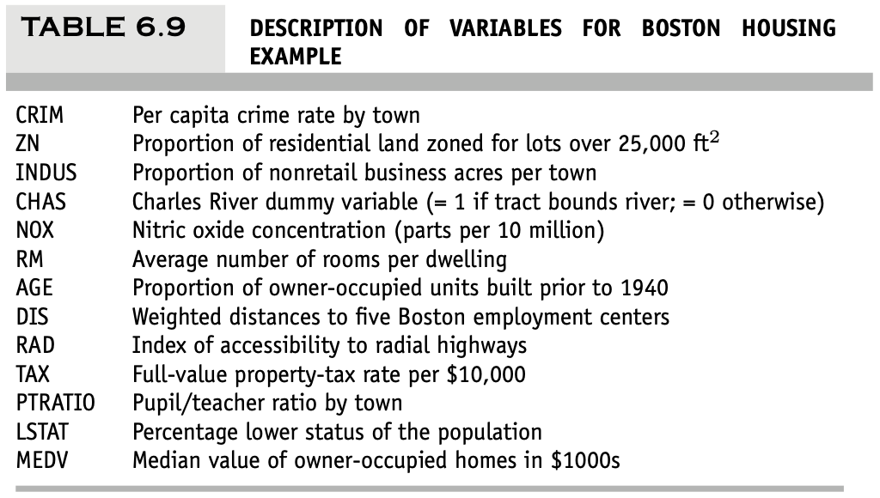
Practice
Predicting Boston Housing Prices.
Fit a multiple linear regression model to the median house price (MEDV) as a function of CRIM, CHAS, and RM.
Write the equation for predicting the median house price from the predictors in the model.
Using the estimated regression model, what median house price is predicted for a tract in the Boston area that does not bound the Charles River, has a crime rate of 0.1, and where the average number of rooms per house is 6? What is the prediction error?
Compute the correlation table for the 12 numerical predictors and search for highly correlated pairs. These have potential redundancy and can cause multi-collinearity. Choose which ones to remove based on this table.
Use exhaustive
Choose the top model.
Then use each of these models separately to predict the validation set.
Compare RMSE, MAPE, and mean error, as well as lift charts.
Finally, describe the best model.
Use stepwise regression with the three options (backward, forward, both) to reduce the remaining predictors. Choose the best model based on AIC.

Slide 43
Practice
Predicting Boston Housing Prices.
Fit a multiple linear regression model to the median house price (MEDV) as a function of CRIM, CHAS, and RM.
reg <- lm(MEDV ~ CRIM + CHAS + RM, data = housing.df)
summary(reg)
Call:
lm(formula = MEDV ~ CRIM + CHAS + RM, data = housing.df)
Residuals:
Min 1Q Median 3Q Max
-24.829 -2.968 -0.415 2.433 38.945
Coefficients:
Estimate Std. Error t value Pr(>|t|)
(Intercept) -28.81068 2.56331 -11.240 < 2e-16 ***
CRIM -0.26072 0.03274 -7.964 1.12e-14 ***
CHAS 3.76304 1.08620 3.464 0.000577 ***
RM 8.27818 0.40182 20.602 < 2e-16 ***
---
Signif. codes: 0 ‘***’ 0.001 ‘**’ 0.01 ‘*’ 0.05 ‘.’ 0.1 ‘ ’ 1
Residual standard error: 6.17 on 502 degrees of freedom
Multiple R-squared: 0.5527, Adjusted R-squared: 0.55
F-statistic: 206.7 on 3 and 502 DF, p-value: < 2.2e-16

Slide 44
Practice
Predicting Boston Housing Prices.
Write the equation for predicting the median house price from the predictors in the model.
MEDV = -28.81068 + (-0.26072 * CRIM) + (3.76304 * CHAS) + (8.27818 * RM)

Slide 45
Practice
Predicting Boston Housing Prices.
Using the estimated regression model, what median house price is predicted for a tract in the Boston area that does not bound the Charles River, has a crime rate of 0.1, and where the average number of rooms per house is 6? What is the prediction error?
> reg$coef %*% c(1, 0.1, 0, 6)
[,1]
[1,] 20.83232
> new <- data.frame(CHAS = 0, CRIM = 0.1, RM = 6)
> pred <- predict(reg, newdata = new, se.fit = TRUE)
> pred$fit
1
20.83232
> pred$se.fit
[1] 0.3348071

Slide 46
Practice
Compute the correlation table for the 12 numerical predictors and search for highly correlated pairs. These have potential redundancy and can cause multi-collinearity. Choose which ones to remove based on this table.
> cor(housing.df[,-c(4)])
> cor(housing.df[,-housing.df$CHAS])
CRIM ZN INDUS NOX RM AGE DIS RAD TAX PTRATIO LSTAT MEDV
CRIM 1.0000000 -0.2004692 0.4065834 0.4209717 -0.2192467 0.3527343 -0.3796701 0.6255051 0.5827643 0.2899456 0.4556215 -0.3883046
ZN -0.2004692 1.0000000 -0.5338282 -0.5166037 0.3119906 -0.5695373 0.6644082 -0.3119478 -0.3145633 -0.3916785 -0.4129946 0.3604453
INDUS 0.4065834 -0.5338282 1.0000000 0.7636514 -0.3916759 0.6447785 -0.7080270 0.5951293 0.7207602 0.3832476 0.6037997 -0.4837252
NOX 0.4209717 -0.5166037 0.7636514 1.0000000 -0.3021882 0.7314701 -0.7692301 0.6114406 0.6680232 0.1889327 0.5908789 -0.4273208
RM -0.2192467 0.3119906 -0.3916759 -0.3021882 1.0000000 -0.2402649 0.2052462 -0.2098467 -0.2920478 -0.3555015 -0.6138083 0.6953599
AGE 0.3527343 -0.5695373 0.6447785 0.7314701 -0.2402649 1.0000000 -0.7478805 0.4560225 0.5064556 0.2615150 0.6023385 -0.3769546
DIS -0.3796701 0.6644082 -0.7080270 -0.7692301 0.2052462 -0.7478805 1.0000000 -0.4945879 -0.5344316 -0.2324705 -0.4969958 0.2499287
RAD 0.6255051 -0.3119478 0.5951293 0.6114406 -0.2098467 0.4560225 -0.4945879 1.0000000 0.9102282 0.4647412 0.4886763 -0.3816262
TAX 0.5827643 -0.3145633 0.7207602 0.6680232 -0.2920478 0.5064556 -0.5344316 0.9102282 1.0000000 0.4608530 0.5439934 -0.4685359
PTRATIO 0.2899456 -0.3916785 0.3832476 0.1889327 -0.3555015 0.2615150 -0.2324705 0.4647412 0.4608530 1.0000000 0.3740443 -0.5077867
LSTAT 0.4556215 -0.4129946 0.6037997 0.5908789 -0.6138083 0.6023385 -0.4969958 0.4886763 0.5439934 0.3740443 1.0000000 -0.7376627
MEDV -0.3883046 0.3604453 -0.4837252 -0.4273208 0.6953599 -0.3769546 0.2499287 -0.3816262 -0.4685359 -0.5077867 -0.7376627 1.0000000

Slide 47
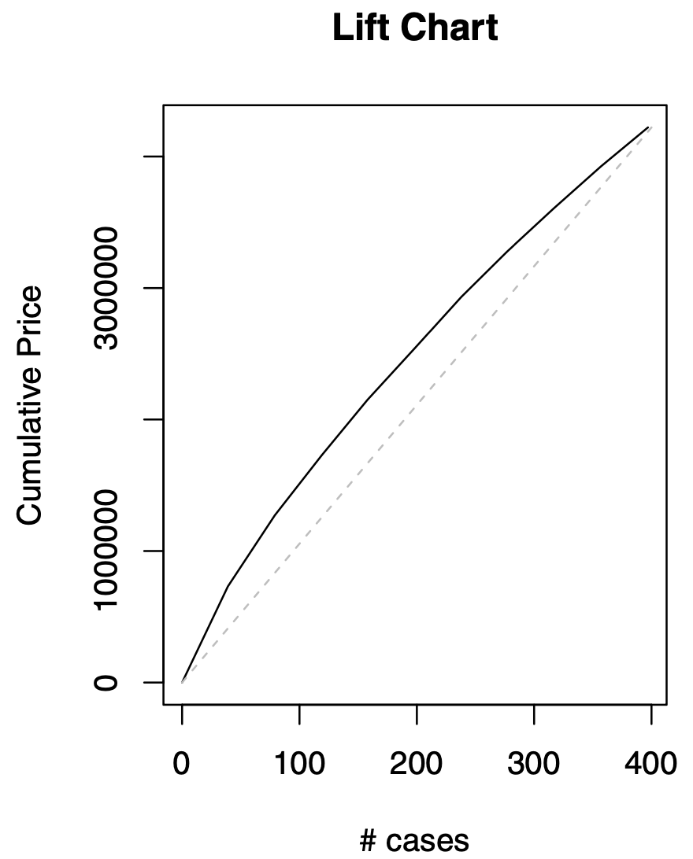

Practice
exhaustive:
Choose the top model based on R²_{adj}.
Then use each of these models separately to predict the validation set.
Compare RMSE, MAPE, and mean error, as well as lift charts.
Finally, describe the best model.
Cumulative Gains and Lift Charts?
Compare responses and predictions: represents the improvement
This curve is compared by assigning a naive prediction ($\overline{y}$) to each record and accumulating these average values (results in a diagonal line)
The further away the lift curve from the diagonal benchmark line, the better the model is doing in separating records

Slide 48
Practice
stepwise regression:
Run stepwise on the training set. Choose the top model from each stepwise run based on R²_{adj}.
Then use each of these models separately to predict the validation set.
Compare RMSE, MAPE, and mean error, as well as lift charts.
Finally, describe the best model.

Slide 49
Summary
Linear regression models are very popular tools, not only for explanatory modeling, but also for prediction
A good predictive model has high predictive accuracy (to a useful practical level)
Predictive models are fit to training data, and predictive accuracy is evaluated on a separate validation data set
Removing redundant predictors is key to achieving predictive accuracy and robustness
Subset selection methods help find “good” candidate models. These should then be run and assessed.
© Galit Shmueli and Peter Bruce 2017

